Slide 1
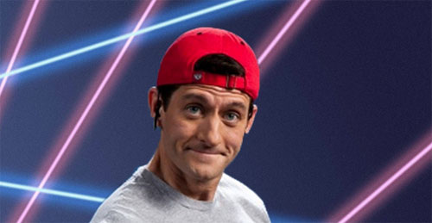
POLS 4600
Prof. Anthony Madonna
The University of Georgia
ajmadonn@uga.edu
9/16/19

Slide 2
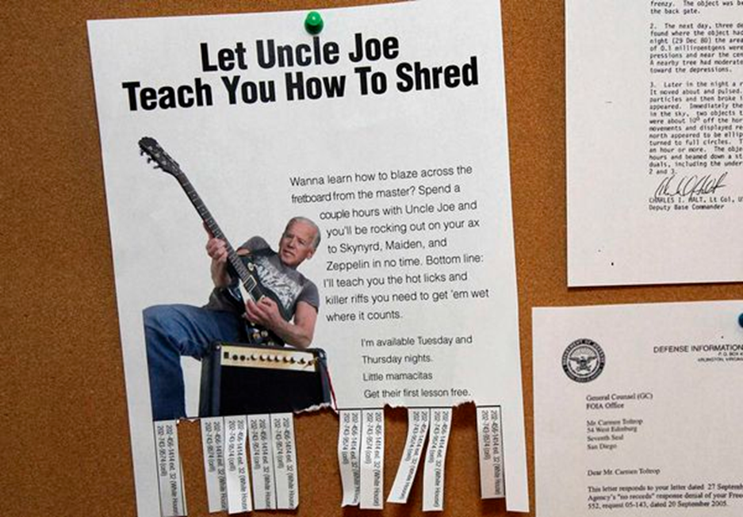
9/16/19 Outline
I. Introduction
email
announcements
news
sign-in
II. History
Reed
Cannon
Rayburn and committee deference
III. Theories
CPG
Cartel Theory
Pivotal Politics
IV. Other House Leaders
Majority Leader
Minority Leader
Majority Whip
Minority Whip
V. Senate Leaders
Presiding Officer
Majority Leader
Minority Leader
Majority Whip
VI. Unidimensional Spatial Model
Trade-off
Ideal point
Single-peakedness
winset
VII. Black’s Median Voter Theorem
Odd #’s
Full participation
Sincere voting
VIII. Committee-Gatekeeper Game
Open v. Closed rules
Exercise
IX. Conclusion
Questions?

Slide 3
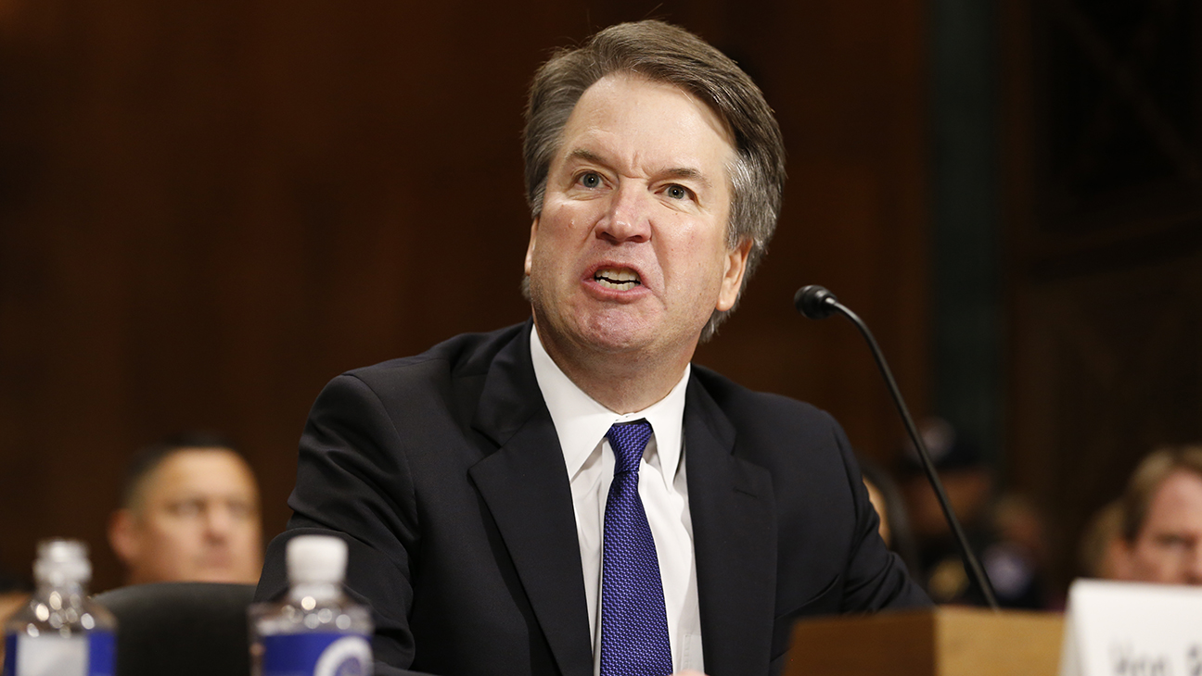
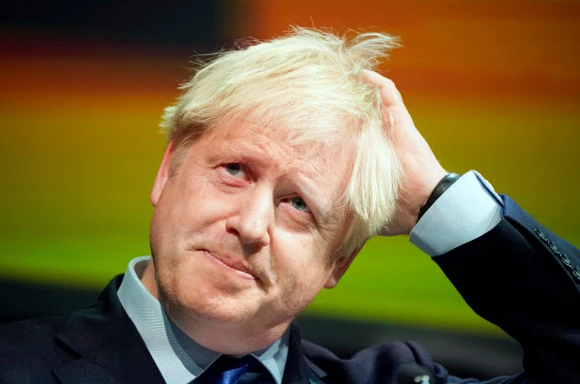
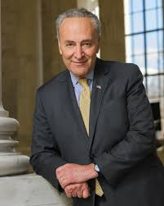
News
A new CBS News poll finds a majority of Americans think action needs to be taken right now to address climate change. “Most consider it at least to be a serious problem — including more than a quarter who say it is a crisis. Seven in 10 think human activity contributes a lot or some to climate change, and most feel they have a personal responsibility to do something about it, although many say they cannot afford to.”
President Trump once again came to the defense of Supreme Court Justice Brett Kavanaugh, Politico reports. Said Trump: “Brett Kavanaugh should start suing people for liable, or the Justice Department should come to his rescue.” Approximately an hour after the original tweet, he sent out a new tweet with the correct spelling of the word “libel.”
“David Cameron has accused Boris Johnson of not believing in Brexit but backing it anyway during the referendum campaign on Britain’s EU membership to advance his political career,” Politico reports. “In an extract from his forthcoming memoir, published in the Sunday Times, the former British prime minister ripped into the political motives of Johnson and Michael Gove, another leading Brexit campaigner who is now a Cabinet minister.”
“Democratic leaders Nancy Pelosi and Chuck Schumer warned President Donald Trump on Sunday that any firearm legislation that falls short of universal background checks for gun sales ‘will not get the job done,’ complicating delicate negotiations between the president and a group of senators,” Politico reports. “Trump has been discussing potential legislation with senators in both parties that would expand background checks but would not go as far as House-passed legislation that would apply them to all gun sales with limited exceptions. Trump issued a veto threat on the House’s background-checks bill earlier this year, and few Republicans in Congress support it.”

Slide 4
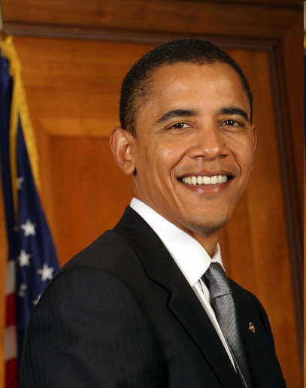
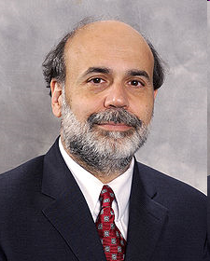
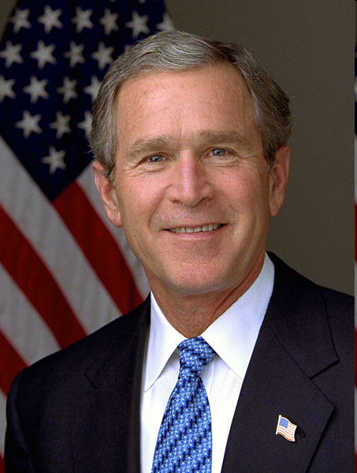
Public Opinion—Partisanship
Gallup has an interesting finding on confidence in Federal Reserve Chairman Ben Bernanke. It seems that perceptions of this ostensibly nonpartisan official depend heavily on which President he happens to be working for. – fivethirtyeight.com Percent Expressing Great Deal/Fair Amount of Confidence in Ben Bernanke:
Democrats Independents Republicans 2008 40 43 61 2009 64 44 36
Notes:
Party identification, like other attitudes, affects beliefs as well as opinions. Attitudes introduce bias into perceptions and interpretations of political information because people tend to pay more attention and give more credence to sources and information that confirm rather than challenge their beliefs.

Slide 5
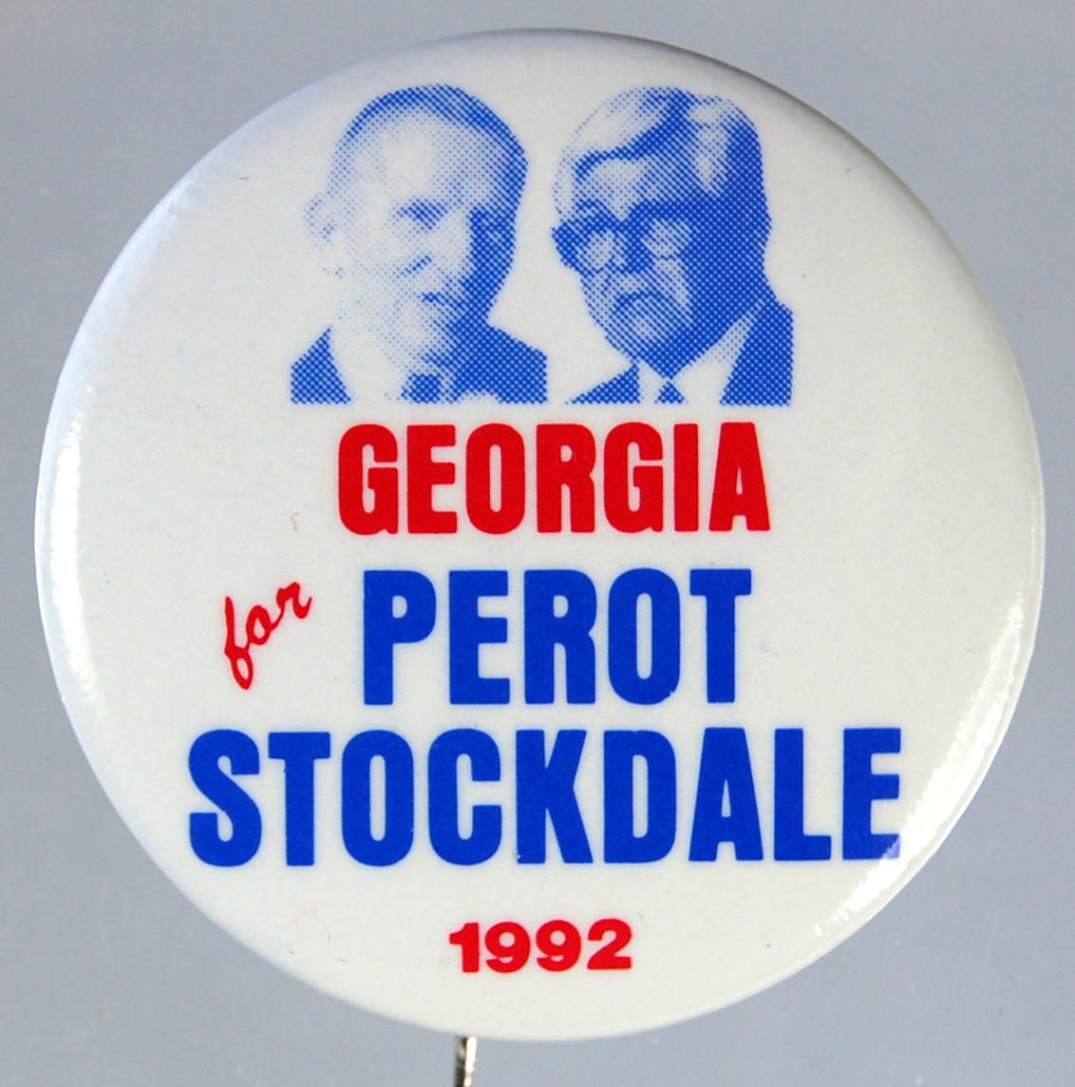
Third Parties and Partisan Realignment
What drives the ideological movement of parties?
What effects do third parties have in American elections?
Miller and Schofield (2003, 245): “Politics may appear to be characterized by a single cleavage, but this is because the two parties [led by ideological activists] themselves ‘organize’ politics along the dimension that separates them. Party disagreement on one dimension of politics makes that dimension more salient, while the other dimension is obscured by tacit party agreement.”
Notes:
A partisan realignment (often just realignment) is a durable shift in a political system's configuration of voters' partisan identifications and political parties' vote shares.

Slide 6
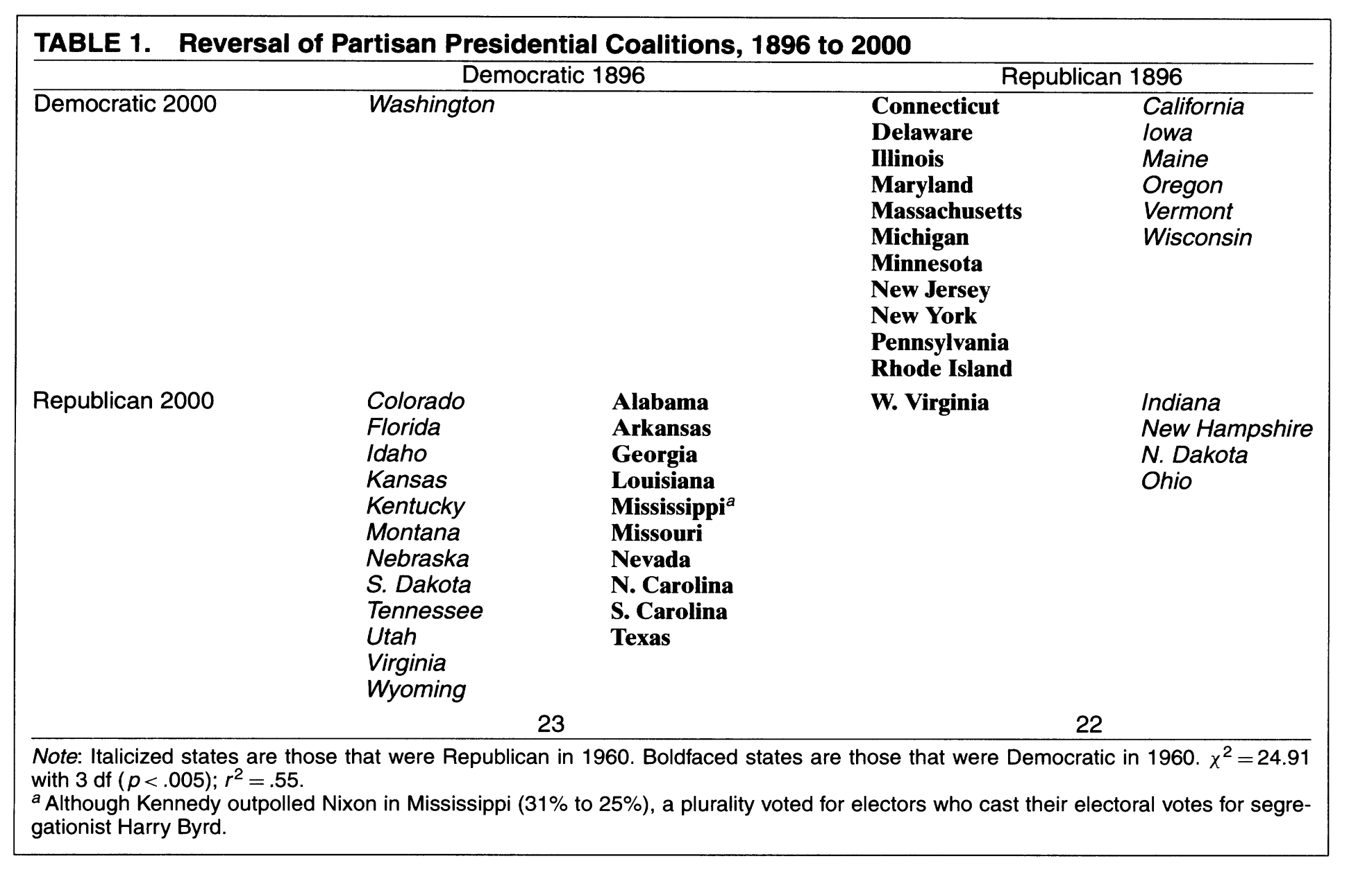
Third Parties and Partisan Realignment

Slide 7
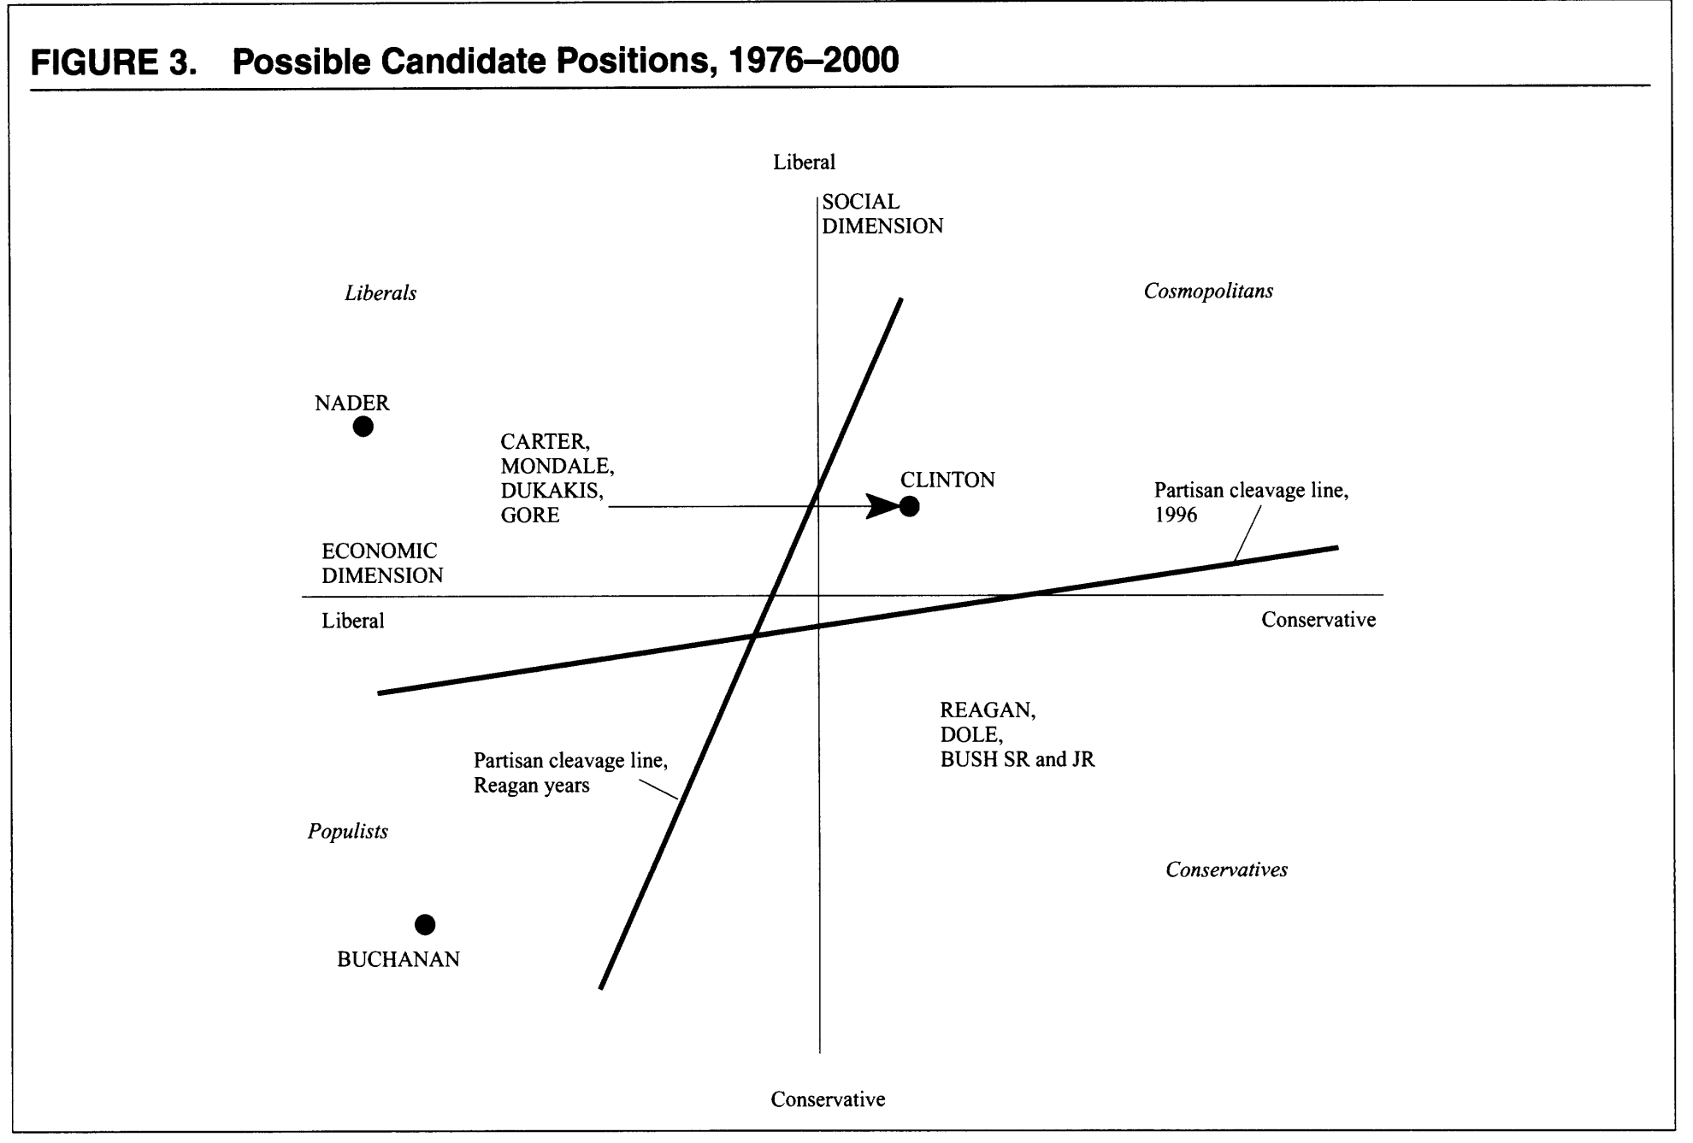
Third Parties and Partisan Realignment

Slide 8
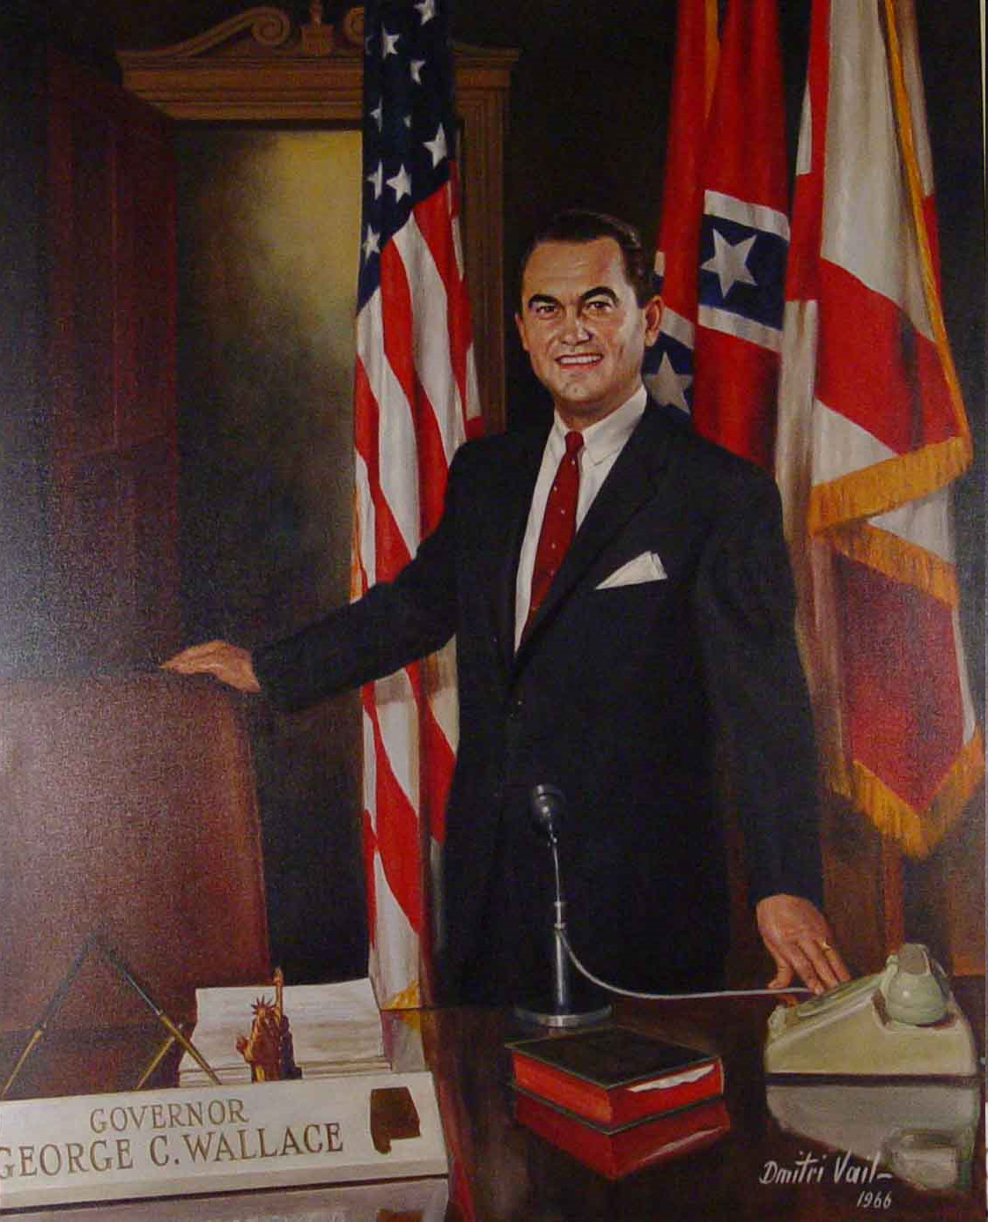
Third Parties and Partisan Realignment
To maximize their vote share relative to their opponents, parties engage in “flanking” maneuvers.
For the modern Republican party, this would mean picking up economic liberals/social moderates.
Third parties – two types:
Dragging (like Ralph Nader) – encourage the party to move back to an old position.
Leading (like George Wallace) – encourage the party to adopt a new position.
"There's not a dime's worth of difference between the Democrat and Republican parties.” – Former Governor and Presidential Candidate George Wallace (D-AL)

Slide 9
9/16/19 Outline
I. Introduction
email
announcements
news
sign-in
II. History
Reed
Cannon
Rayburn and committee deference
III. Theories
CPG
Cartel Theory
Pivotal Politics
IV. Other House Leaders
Majority Leader
Minority Leader
Majority Whip
Minority Whip
V. Senate Leaders
Presiding Officer
Majority Leader
Minority Leader
Majority Whip
VI. Unidimensional Spatial Model
Trade-off
Ideal point
Single-peakedness
winset
VII. Black’s Median Voter Theorem
Odd #’s
Full participation
Sincere voting
VIII. Committee-Gatekeeper Game
Open v. Closed rules
Exercise
IX. Conclusion
Questions?

Slide 10
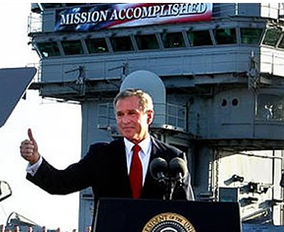
Conclusion
Questions? Concerns? Angry rants?
Enjoy the rest of your day!

